Slide 1

Neuralink: revolutionizing our lives with smart prosthetics
Brian Eduardo Casio Iracheta

Slide 2
Main points:
Definition of Neuralink and smart prosthetics
Whether these should exist
Pros and cons.
Conclusion

Slide 3
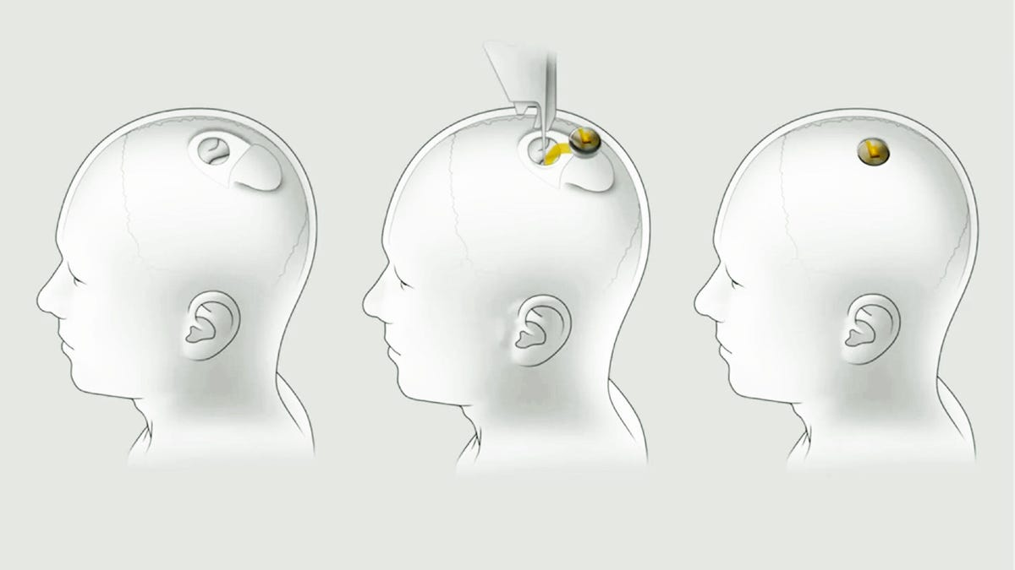
Neuralink and smart prosthetics definition.
Neuralink is a brain-computer interface fully implantable, cosmetically invisible, and designed to let you control a device anywhere you go (Becher, 2024).
Artificial body part or extension that can read the user’s electrical or mechanical signals from the new device and act accordingly (Joiner, 2022).
40 brain-computer interface trials under way

Slide 4
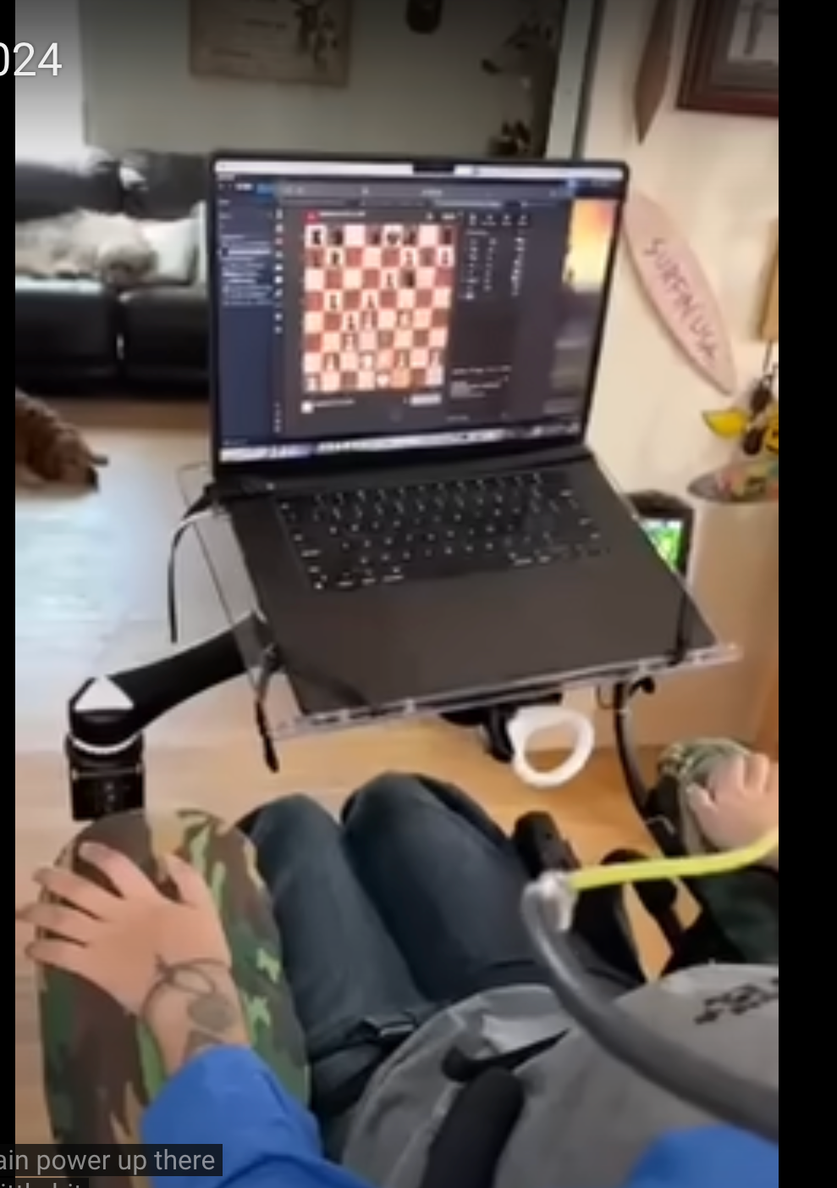



Slide 5
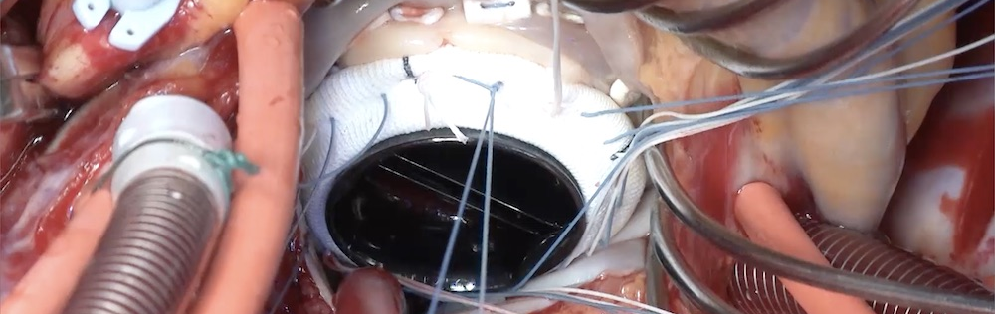
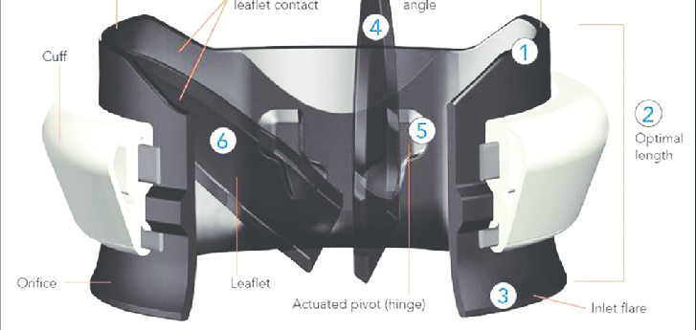

To be, or not to be? Existence of Smart Prosthetics
Should devices like this exist? These already exist!
On-X valve (Chaudary, 2017).
Disabilities: smart prosthetics supports basic human rights (United Nations, 2022).

Slide 6
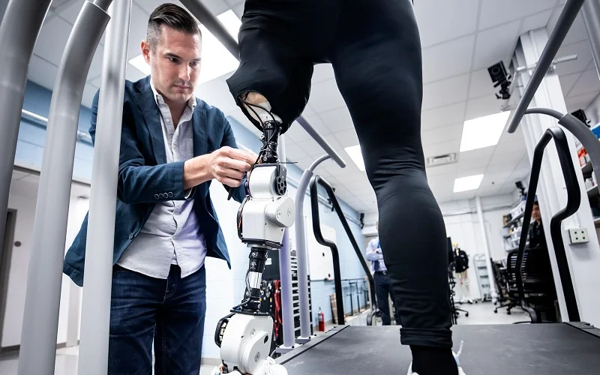
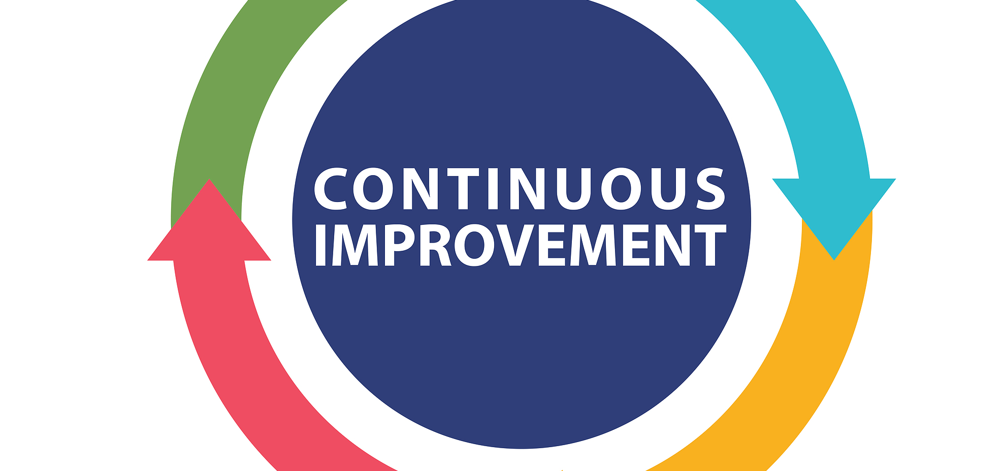

Pros and cons of smart prosthetics.
Pros:
enhanced functionality, neural integration, continuous improvement. (Sakharkar, 2022).
Cons:
privacy concerns, accessibility and affordability, ethical dilemmas.

Slide 7
Conclusion
Big step forward in assistive technology.
They help with the quality of life of people who need them and make society more inclusive.
I hope that now you see this technology with new eyes and hopefully we never have the need to use this kind of technology for ourselves or our loved ones, but I desire a future where their assistance is readily accessible when needed.

